Slide 1
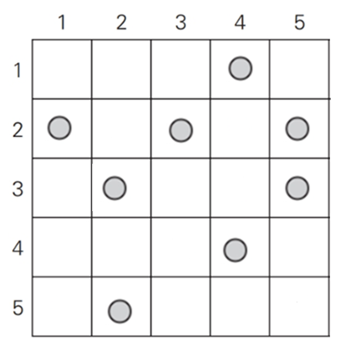
Exercise (1 of 2)
Assume that you have a board of 5 x 5 with 8 coins like below.

Slide 2
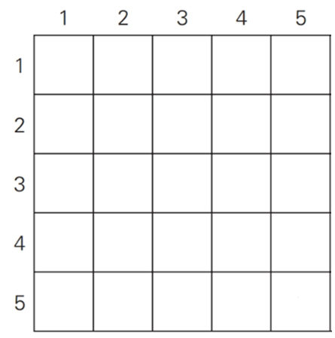
Exercise (2 of 2)
Fill out the following table to indicate the number of coins collected in each cell.
  Additionally, present the optimal path.

Slide 3
Important Note
Do not see the answer immediately on the next page.
  Try to solve it by yourself and then compare your solution with the answer.

Slide 4
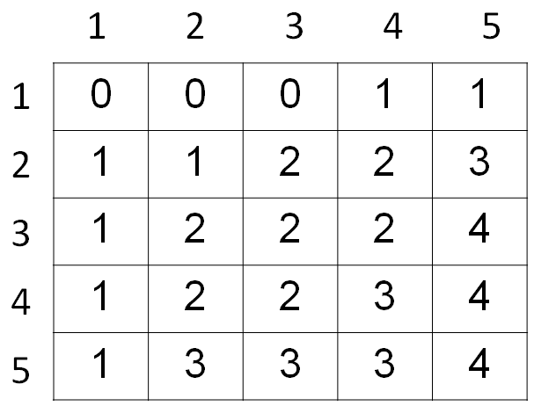
Solution (1 of 2)

Slide 5
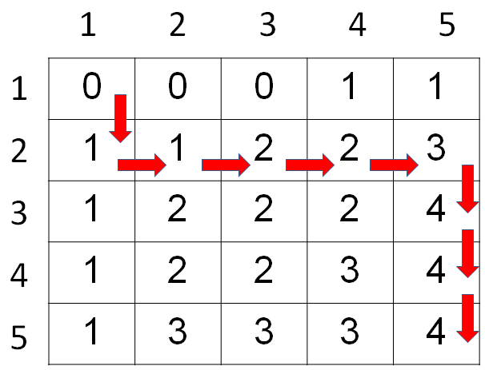
Solution (2 of 2)
This is the optimal path.
  You can get it using the backtracking.

